Slide 1


A little guide to building Large Language Models in 2024
thomas@huggingface.co

Slide 2
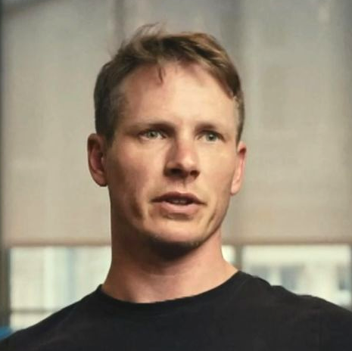
Hi!
CSO and Co-founder of Hugging Face
Created Hugging Face Transformers and Datasets libraries.
Exploring Open-science in research in AI/ML, trying to lower the gap between academia and industrial labs through projects like the BLOOM/BigScience Workshop Co-wrote "Natural Language Processing with Transformers" (O'Reilly)
Push for lowering the access barrier in AI for researchers and practitioners
Website: https://thomwolf.io
E-Mail: thomas@huggingface.co
Twitter: @thom_wolf
LinkedIn: @thom-wolf

Slide 3
Plan of today
Quick overview of Hugging Face
LLMs in 2024 at Hugging Face
data
training
evaluation
alignment
inference
Closing notes

Slide 4
WTF is Hugging Face?

Slide 5








Open vs Closed Models
Open and closed models have different benefits and should be considered for each use-case
 | Open-Source | Closed / Proprietary
Security | Models can be self-hosted, data stays in your environment | Models cannot be self-hosted. Data is sent outside your environment to vendor
Control | The timing and nature of updates are controlled by you | Updates and changes to performance can happen without notice
Customization | Full source code access to customize the model for your needs | Limited ability to customize for your needs
Transparency | Inspect code and data provides better auditability and understandability | No ability to audit or understand performance
Cost | Typical lower long term cost due to smaller model size | larger model size and proprietary premium often balanced by decreased cost from server-side optimization
Latency | Lower latency due to on premise and smaller model sizes | Often greater latency due to larger model sizes + API latency
Quality | No single approach is best. Each use case will vary. Proprietary is typically closer to the frontier of performance.
Examples

Slide 6
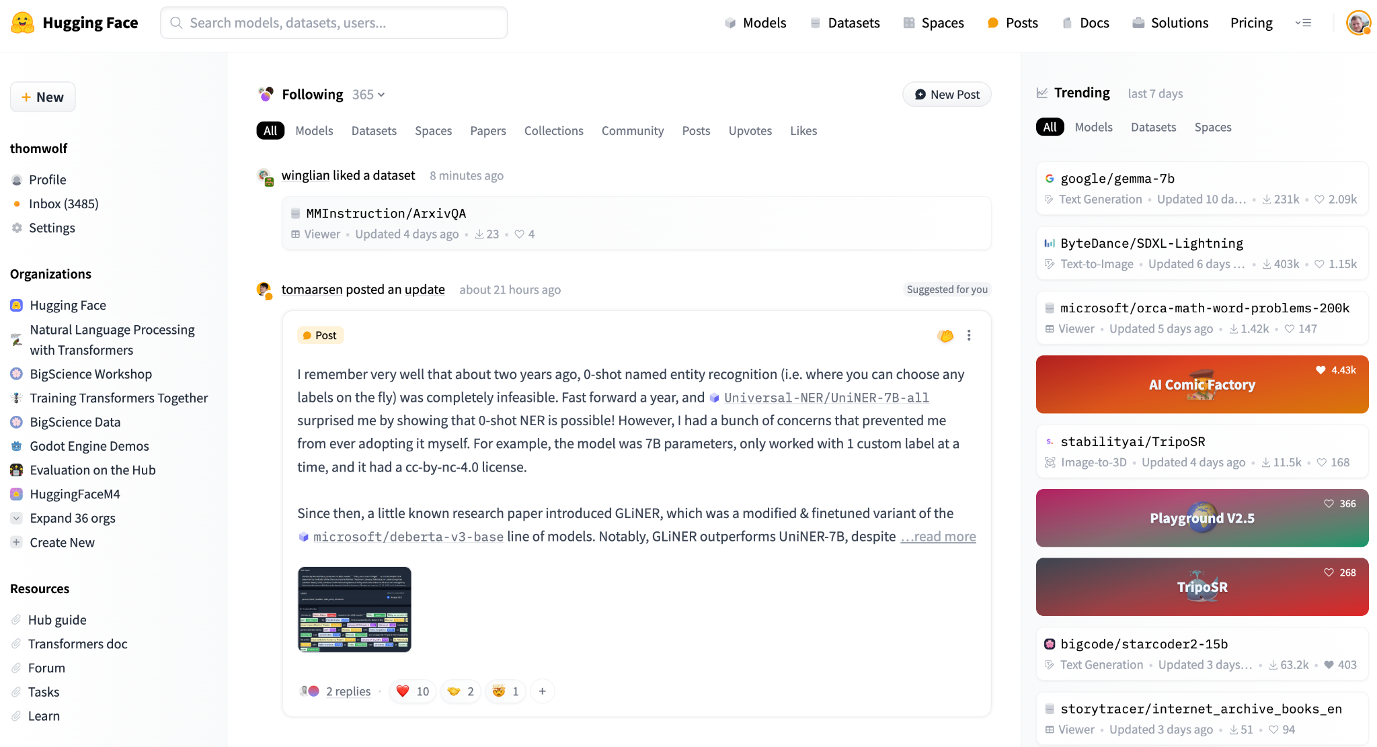
Founded In
2016
170 Employees
100K+
public data sets
1M+
daily downloads
700K+
daily visitors
300K+
stars on Github
30+
Libraries
500K+
open source models
Hugging Face: The home of open ML

Slide 7




































Used everywhere in the AI world
15,000+ startups and enterprises
Open source contributors
Cloud partners
Hugging Face
Hardware partners
On-prem partners

Slide 8
















Integrated with the ML ecosystem
Model in production
NVIDIA
DGX Cloud
Hugging Face on Azure
Amazon SageMaker
Google
Cloud
Open Datasets
Managed Inference on AWS, Azure and GCP
100,000+ datasets on the hub
Cloud Platforms
Deploy
anywhere
No-code AutoML
500,000+ models
on the hub
Transformers
Accelerate
Open Models
Hosted ML applications
Diffusers
Optimum
HW-accelerated training & inference

Slide 9

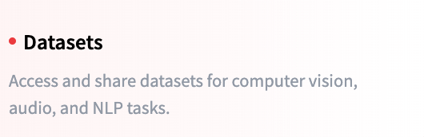
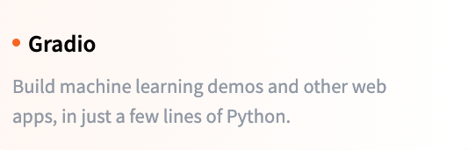
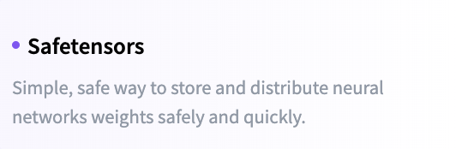
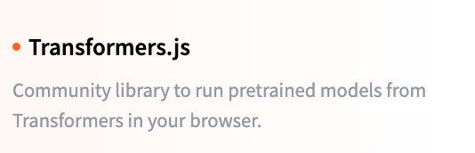

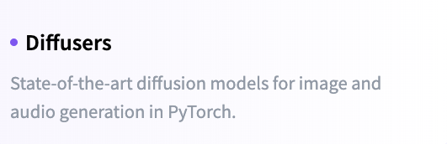
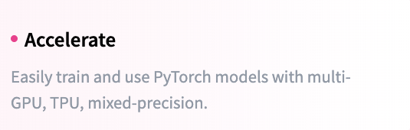
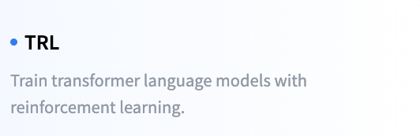
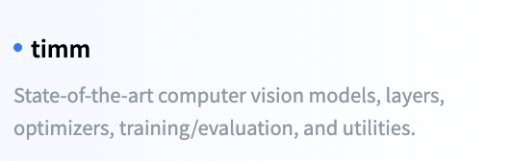
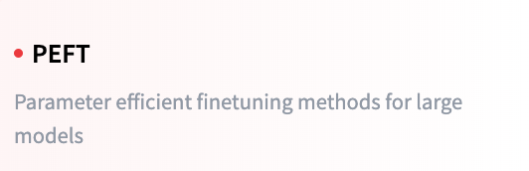
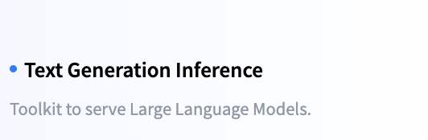
Open-source Ecosystem

Slide 10
LLMs in 2024
at Hugging Face

Slide 11
The workflow for LLMs
I – Training:
data preparation – datatrove
efficient training techniques – nanotron
evaluation – lighteval
II – Fine-tuning:
RLHF – TRL
III – Inference:
quantization – bitsandbytes
deployment – Text Generation Inference

Slide 12
Energy/carbon footprint and LLMs
Start by test existing models on your domain and task(s) of interest
Most of the time the answer is “no” =>
Focus on efficient fine-tuning and inference
Do you need to pretrain an LLM?
Yes =>
Focus on efficient pretraining while taking a holistic view of model life-cycle
Energy budget will likely be dominated by inference costs. Select a compute efficient model: - smallest size
- quantized - classification models > generative
Train-compute-optimal models (Chinchilla law) are not efficient for inference
Train smaller models for longer if you plan to deploy it at large scale
Train in a cluster/provider with a good energy mix
Deploy it in a setup/cloud provider in a region with a good energy mix
Share the model so people can re-use/leverage the compute spent – It’s like recycling AI models
Ressources: - Power Hungry Processing: Watts Driving the Cost of AI Deployment? https://arxiv.org/abs/2311.16863
- Language models scale reliably with over-training and on downstream tasks https://arxiv.org/abs/2403.08540
- Region energy mix (e.g. solar, nuclear, coal, gas) can have a x500 impact on model carbon footprint: https://app.electricitymaps.com/

Slide 13
Training:
1. Data preparation

Slide 14


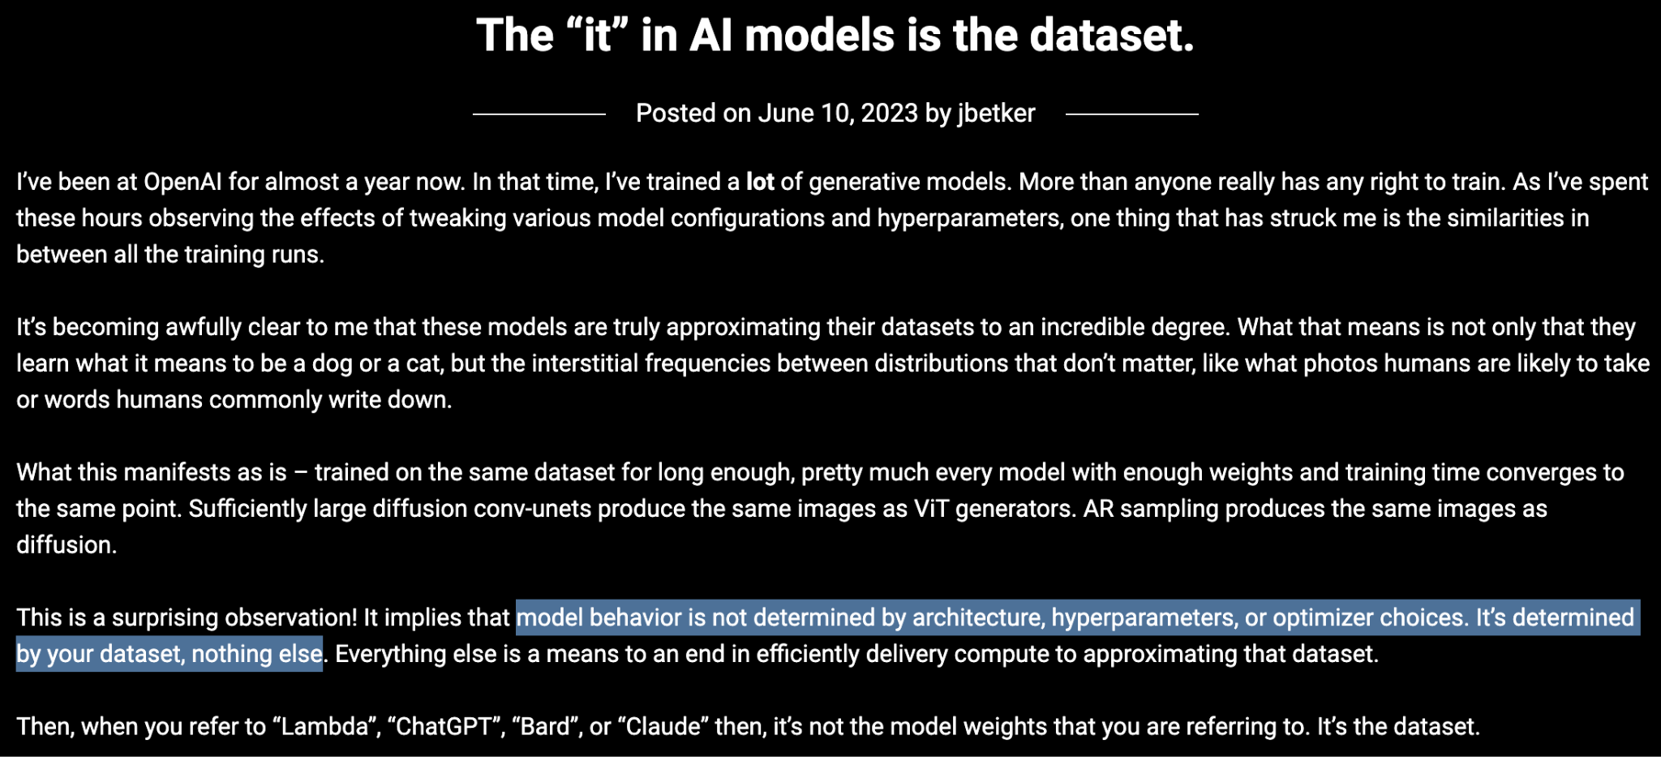
I – Training
Often a lot of focus on models architecture but…
https://nonint.com/2023/06/10/the-it-in-ai-models-is-the-dataset/

Slide 15
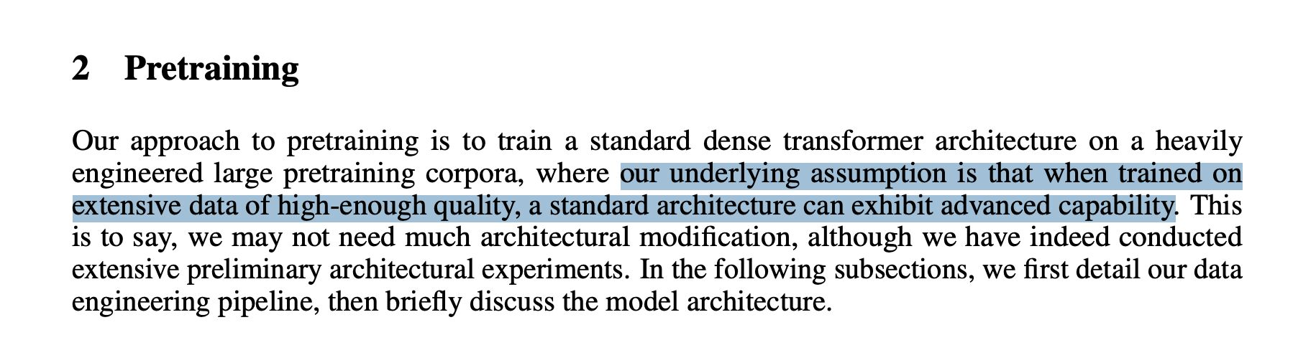
I – Training
Yi: Open Foundation Models by 01.AI https://arxiv.org/abs/2403.04652

Slide 16
I – Training
I – Data preparation:
Latest resources
A Survey on Data Selection for Language Models https://arxiv.org/abs/2402.16827
Yi: Open Foundation Models by 01.AI https://arxiv.org/abs/2403.04652
Recent dataset reports
Dolma (AllenAI): an Open Corpus of Three Trillion Tokens for Language Model Pretraining Research https://arxiv.org/abs/2402.00159
RefinedWeb (Falcon): Outperforming Curated Corpora with Web Data, and Web Data Only https://arxiv.org/abs/2306.01116

Slide 17
Data preparation
LM training requires multiple stages:
pretraining
instruction-tuning
alignment
in-context learning
task-specific fine-tuning
each training stage has different goals
data selection methods will use different mechanisms

Slide 18
Data preparation
Pretraining stage:
Goal: train a general-purpose model – maximal coverage
Requires: train on massive quantities of text, at least 1 trillion of tokens nowadays
Challenges:
maximizing diversity and coverage
maximising quality, robustness
data quality evaluation: how to measure data quality at the billion tokens scale

Slide 19
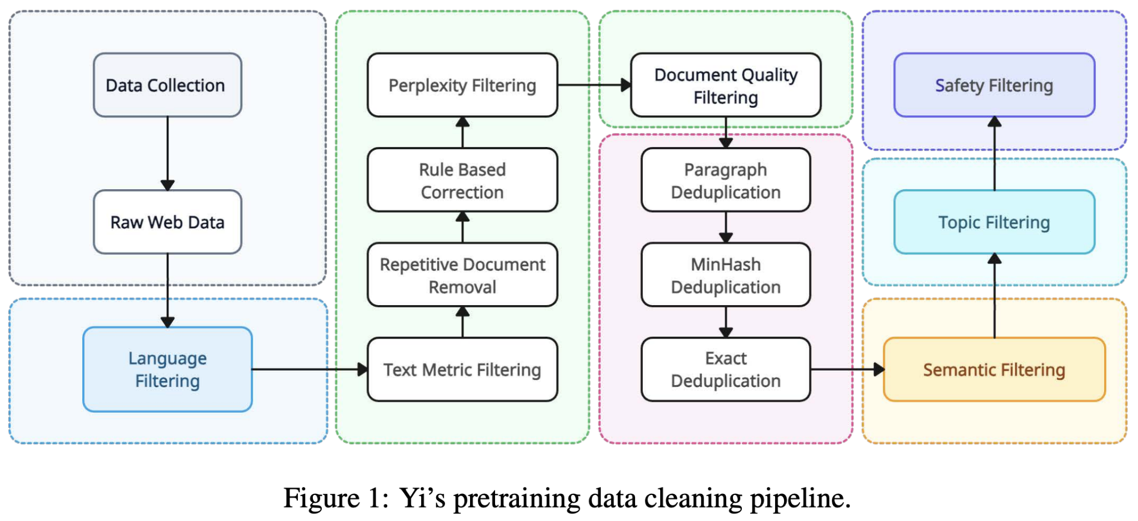
Data preparation

Slide 20
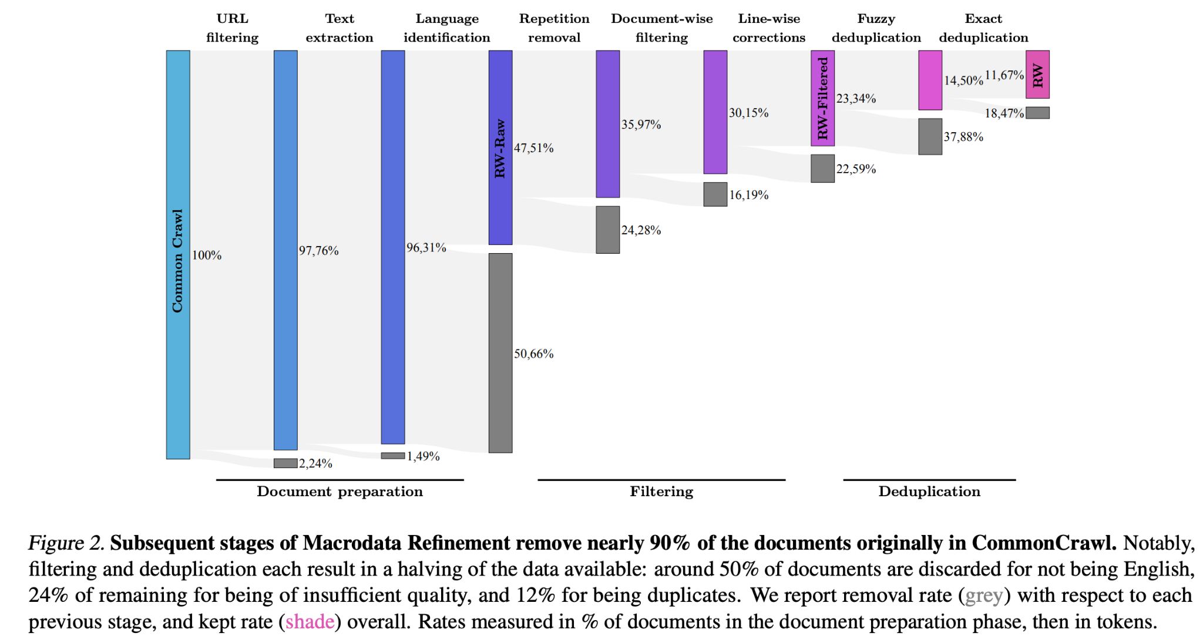
Data preparation

Slide 21
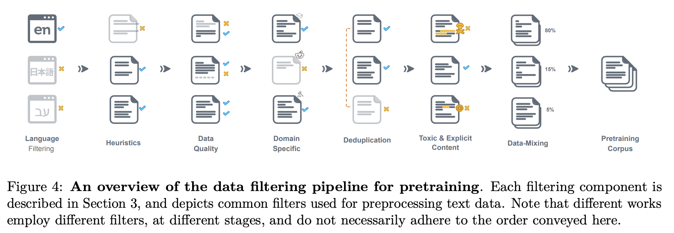
Data preparation

Slide 22
Data sources
Data sources
Very large (> 100B tokens):
Common crawl: everyone starts from here
Code: Github and Software Heritage
Curated:
Wikipedia
Books: public-domain vs. copyrighted
More recent trends
Synthetic data

Slide 23

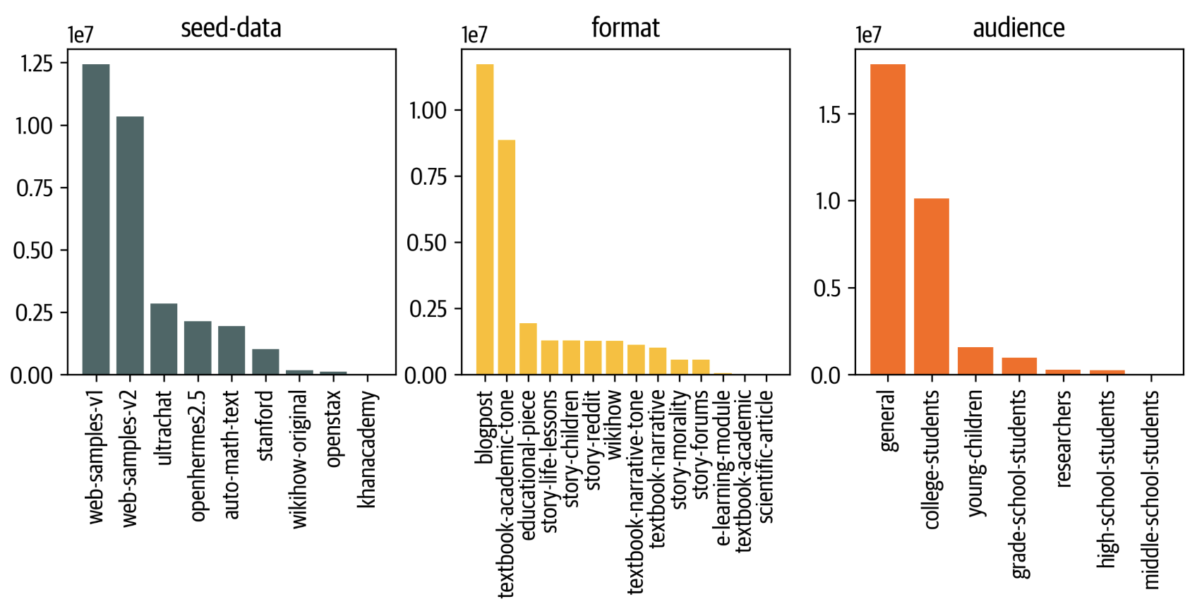
Synthetic data: Cosmopedia v0.1 🛰️
A synthetic dataset of 30M samples
generated by Mixtral-8x7B-Instruct-v0.1
8 splits:
various sources for seed samples: Stanford, OpenStax and KhanAcademy, webdata, instruction-tuning datasets
model is asked to generate content

Slide 24
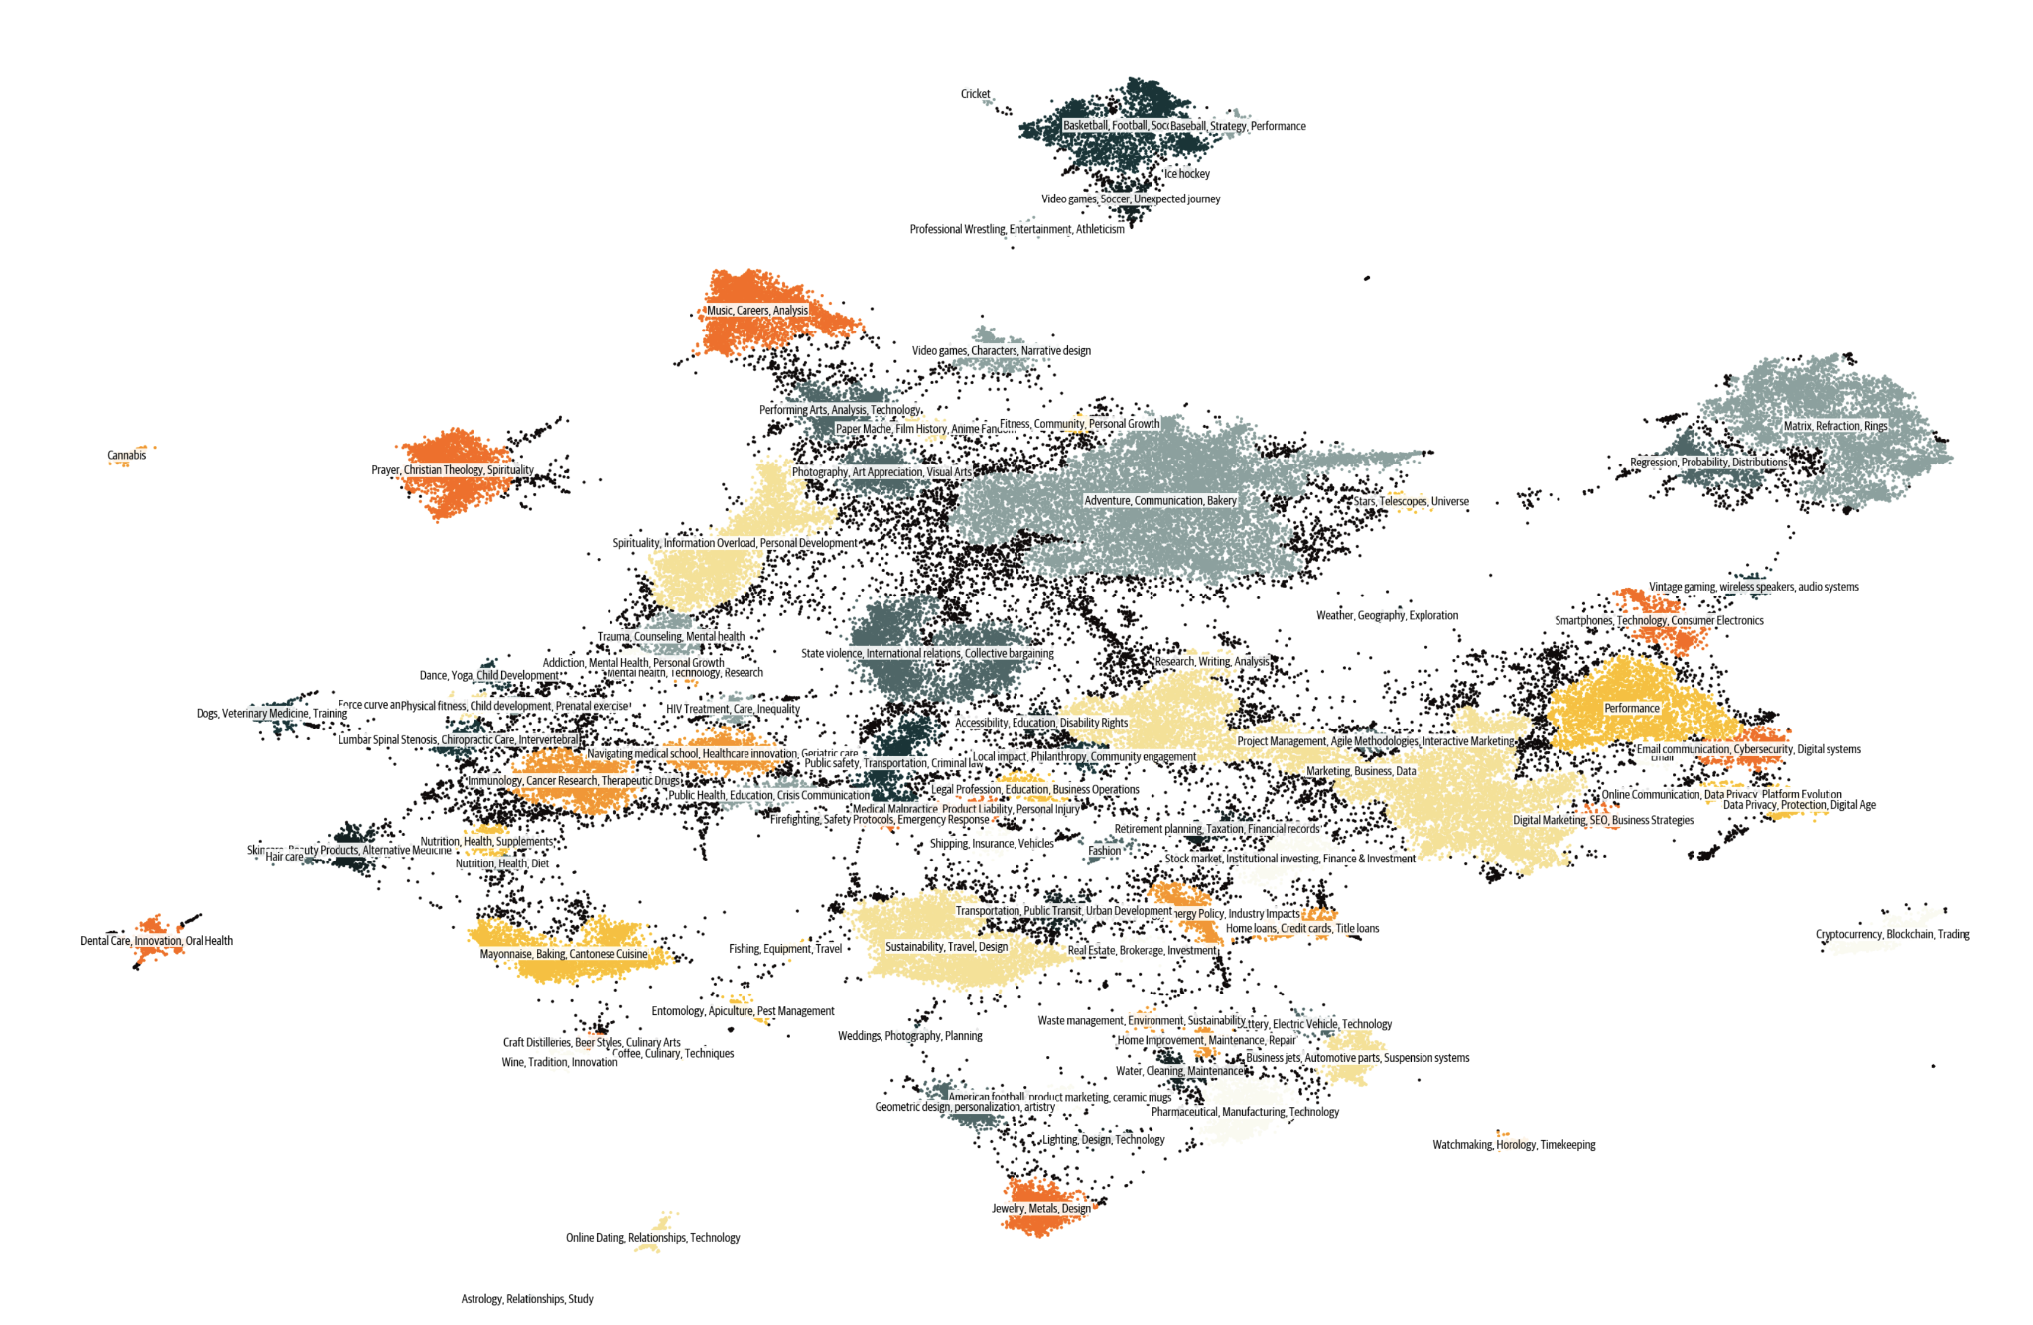
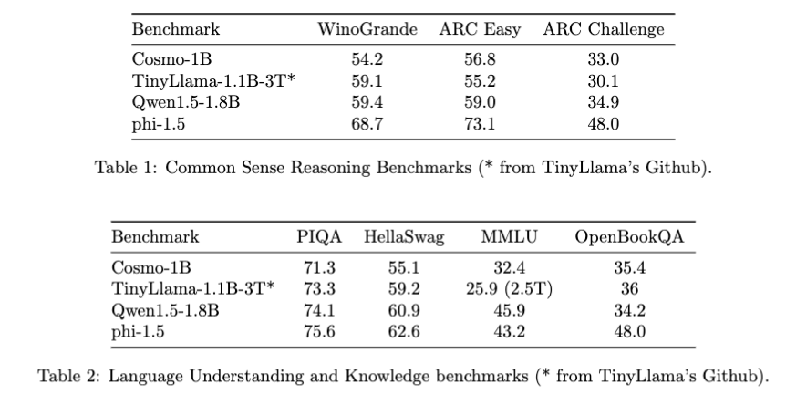
Cosmopedia v0.1 🛰️

Slide 25
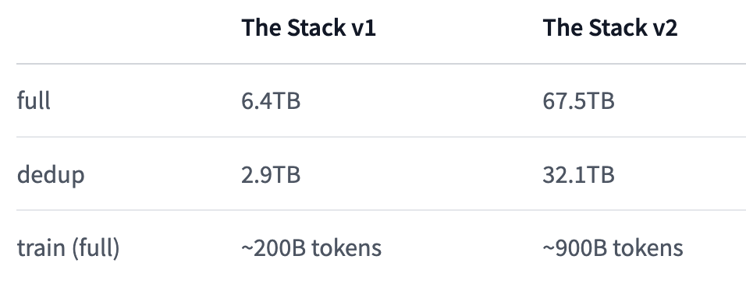
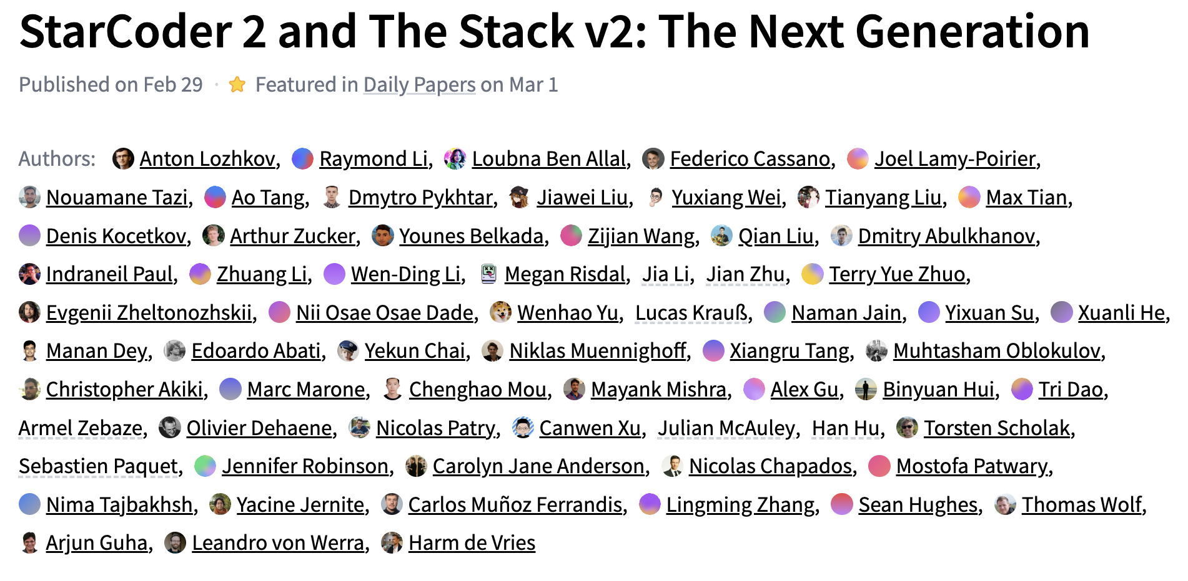
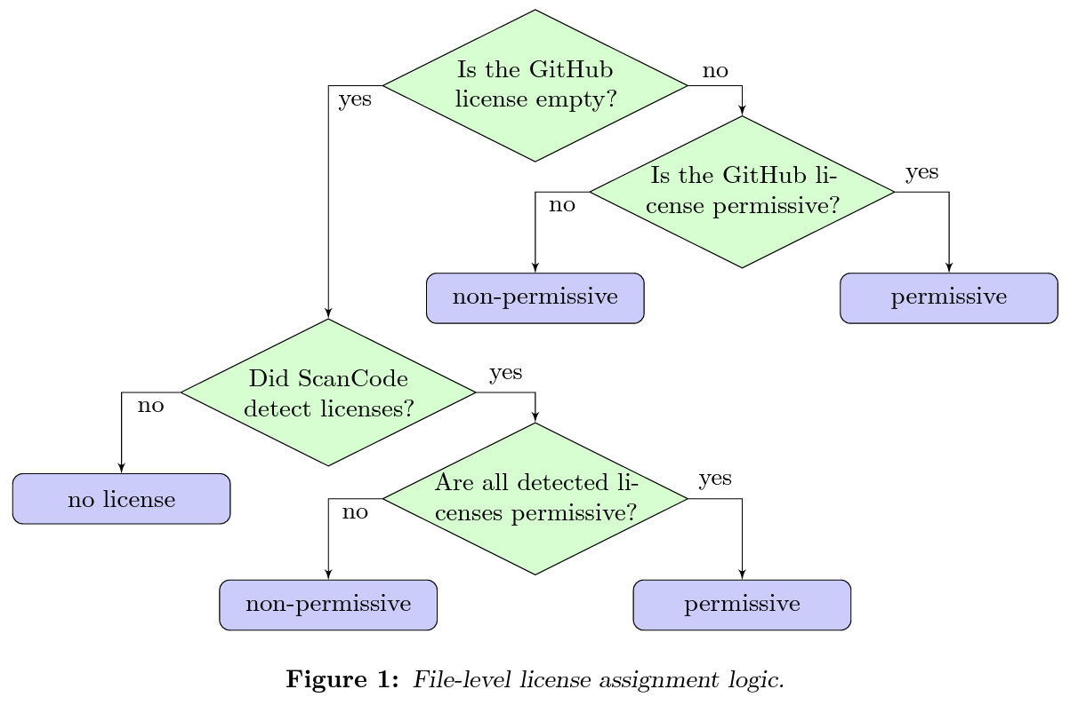
Code data: StarCoder 2 – The Stack v2 💫
3B+ files in 658 programming languages
created as part of the BigCode Project pre-training dataset for Code LLMs
Derived from the Software Heritage archive: largest public archive of software source code

Slide 26
webdata: FineWeb
Coming soon….

Slide 27

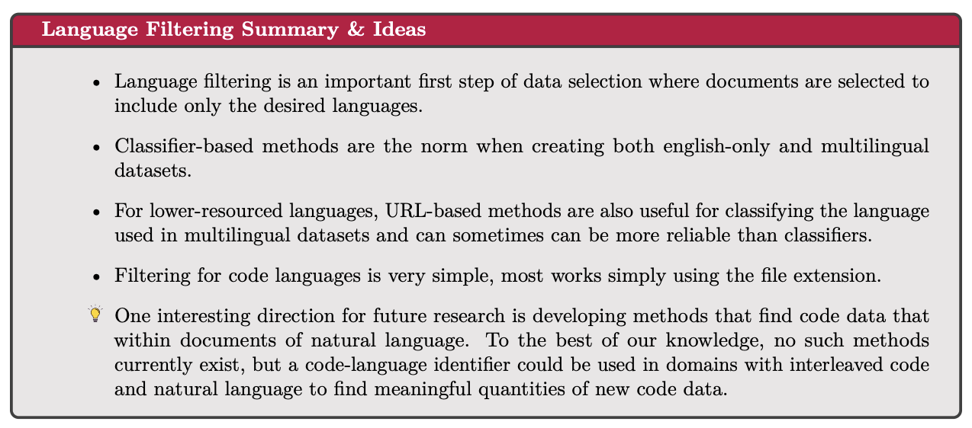
Language filtering

Slide 28
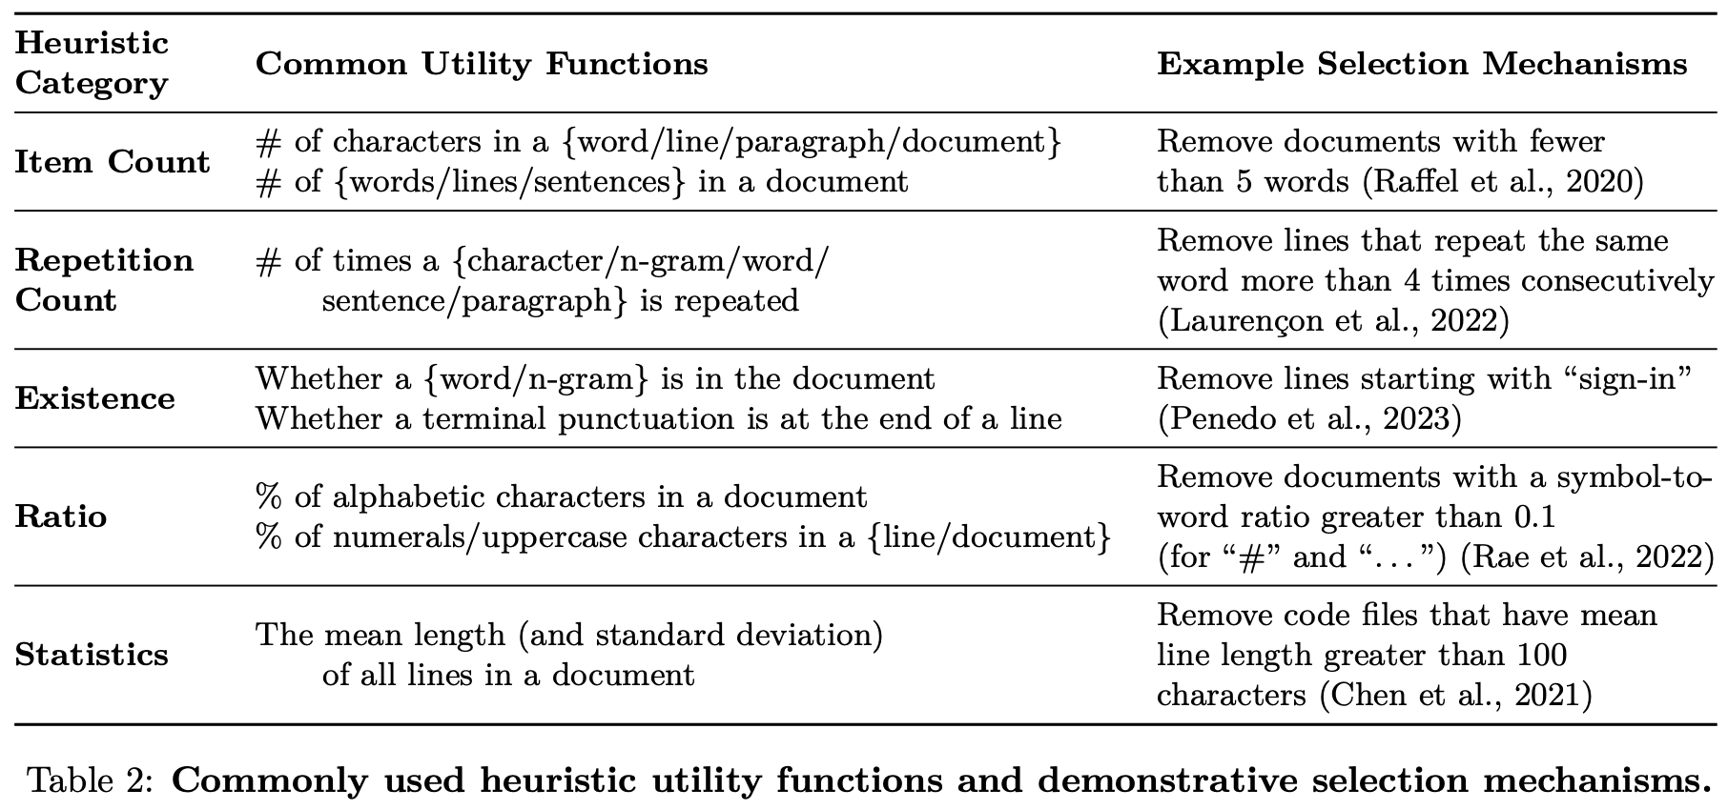
Quality filtering heuristics
heuristics

Slide 29
Quality filtering heuristics
Advantages
controlled
robust
rather clear priors
Drawbacks
rely entirely on surface level
danger of removing too much
hyper-parameter tuning

Slide 30
Quality filtering – ML filtering
Given a set of examples of good/bad documents:
classifier-based quality filtering: fastText classification with an n-gram size of 2
perplexity based filtering: 5-gram Kneser-Ney model on Wikipedia
Filter based on a threshold
Allow for more “quality/content based filtering” but harder to estimate the impact of the training documents.
May introduce unwanted “bias”

Slide 31
Notes on data filtering
Taking care of domains specificities
important to inspect the effect on domain specific data
extract 10 documents per domains (e.g. top urls)
manually inspect the results
craft domain specific filters/hyper-parameters
same for multiple languages
Deterministic vs. stochastic selection
hard threshold are strong decision points
stochastic smoothing of rules

Slide 32
Data deduplication
Reasoning: a lot of duplicate/near duplicate documents in large scale dumps (internet/github…)
increases the distribution density around those areas
duplicated data point have more chance of being memorized (Carlini et al. (2023))
filtering out duplicates reduce training time
reducing duplication improve accuracy on downstream tasks (Lee et al., 2022a; Tirumala et al., 2023)

Slide 33
Data deduplication
methods:
Fuzzy:
BLOOM filters (hashing and fixed size vector)
MinHash (hashing and sorting)
Exact
Exact substring with suffix array
Sentence dedup
time/memory consumption
MinHash offers a good trade–off of speed/memory with more control than BLOOM filters
counter intuitive results
more deduplication may lead to keeping only bad data

Slide 34
Preparing the data for training
Shuffle:
Important!
Tokenizers – some good practices:
Sample quite widely in your dataset (don’t overfit to a subset)
For math: be careful of numbers – either split digits or add them manually
For code: be careful of spaces – handle them well to group them
Byte-level BPE is a good standard – Byte fallback is good as well
Scaling tokenization:
Tokenization of trillions token can be non negligible
tokenize dynamically during training
parallelize pretokenization in small data sub-sets

Slide 35
How to evaluate data quality
1. Small models trainings: train 1-2B size models on 30GT
Use a set of “high-signal” benchmarks (in NLP):
commonsense QA
hellaswag
openbook QA
PiQA
High-signal?
monotonicity: monotonically increasing during training
low variance:
when comparing two known reference datasets (e.g. The Pile versus C4)
when comparing with various sub-parts of data and seeds
above random baseline
Tricky details to maximize signal:
Small models like “normalized loglikelihood” better
Larger models like “letter answers” better
SIQA
winogrande
ARC
MMLU

Slide 36

How to evaluate data quality
2. Manual data inspection
Inspect 10 documents for your top domains/URLs
Inspect at various stage until post tokenization
Inspect kepts and discarded documents
Search tools in the dataset
3. Maps and clustering
https://github.com/huggingface/text-clustering
4. Uncommon: training a tokenizer and inspect the top/last/longest tokens :)

Slide 37
datatrove
Quick intro

Slide 38
datatrove
Started as an open reproduction of RefinedWeb
Ended up in a fully-fledged lightweight library for processing, filter and deduplicate text data at a very large scale.
Provides prebuilt commonly used processing blocks with a framework to easily add custom functionality.
Full python
Local, remote and other file systems are supported through fsspec.
Scaled to 20k+ nodes on SLURM

Slide 39
lighteval
Quick intro

Slide 40
lighteval
Lightweight LLM evaluation suite
Allow to evaluate models with 3D parallelism
Custom evals and prompt explorations
Push to hub/WandB/tensorboard

Slide 41
Training:
2. Modeling

Slide 42
Training the model
Training LLM: the essential elements
size/efficiency
parallelism
asynchronicity
kernel merging
attention
instabilities
stable training recipes
capacity
mixture of experts
mamba

Slide 43
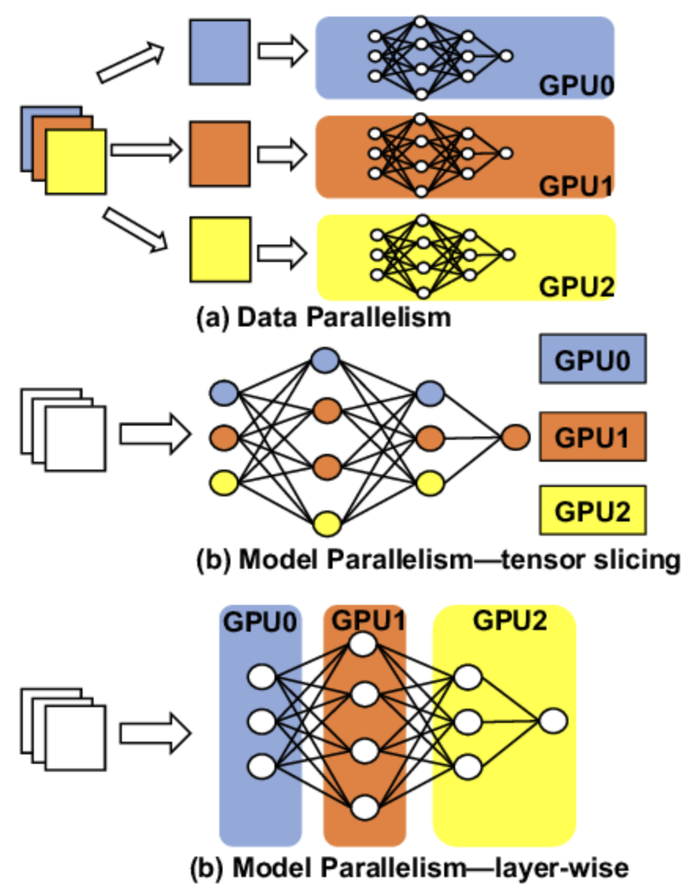
When the model is too big:
Parallelism
4D Parallelism:
Data Parallelism
Tensor Parallelism
Pipeline Parallelism
Sequence Parallelism

Slide 44
When the model is too big:
Data Parallelism
4D Parallelism:
Data Parallelism
usually work out-of-the-box
just need to be careful with dataloading
challenges:
compute efficiency for gradient all-reduce
training efficiency of batch-size
Tensor Parallelism
Pipeline Parallelism
Sequence Parallelism

Slide 45
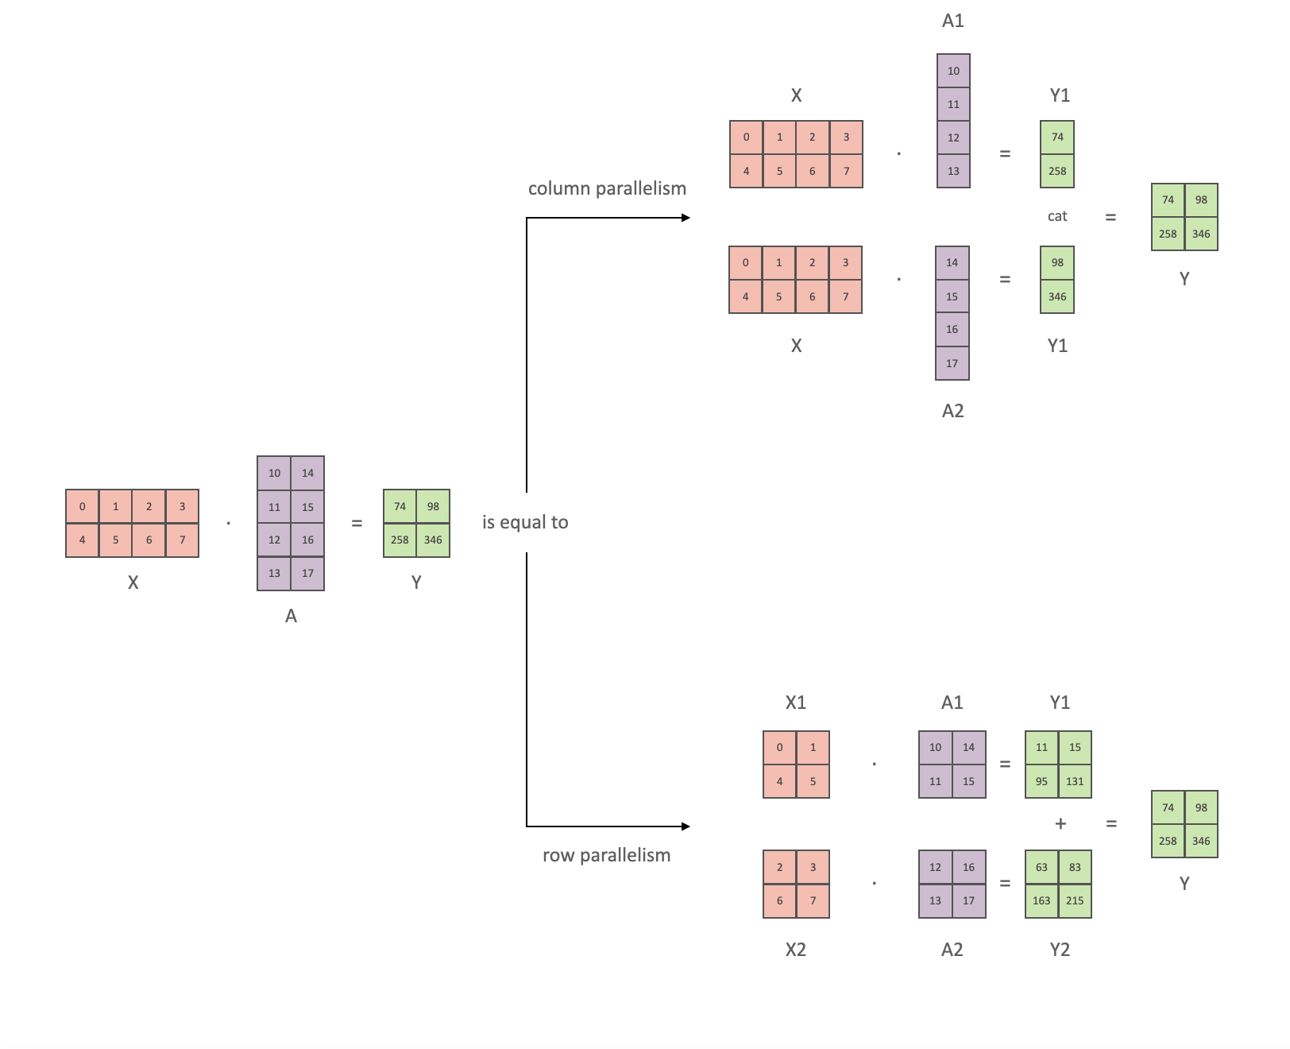
When the model is too big:
Tensor Parallelism
4D Parallelism:
Data Parallelism
Tensor Parallelism
Re-write model code
Combine collumn/row slicing to reduce sync points
Pipeline Parallelism
Sequence Parallelism

Slide 46
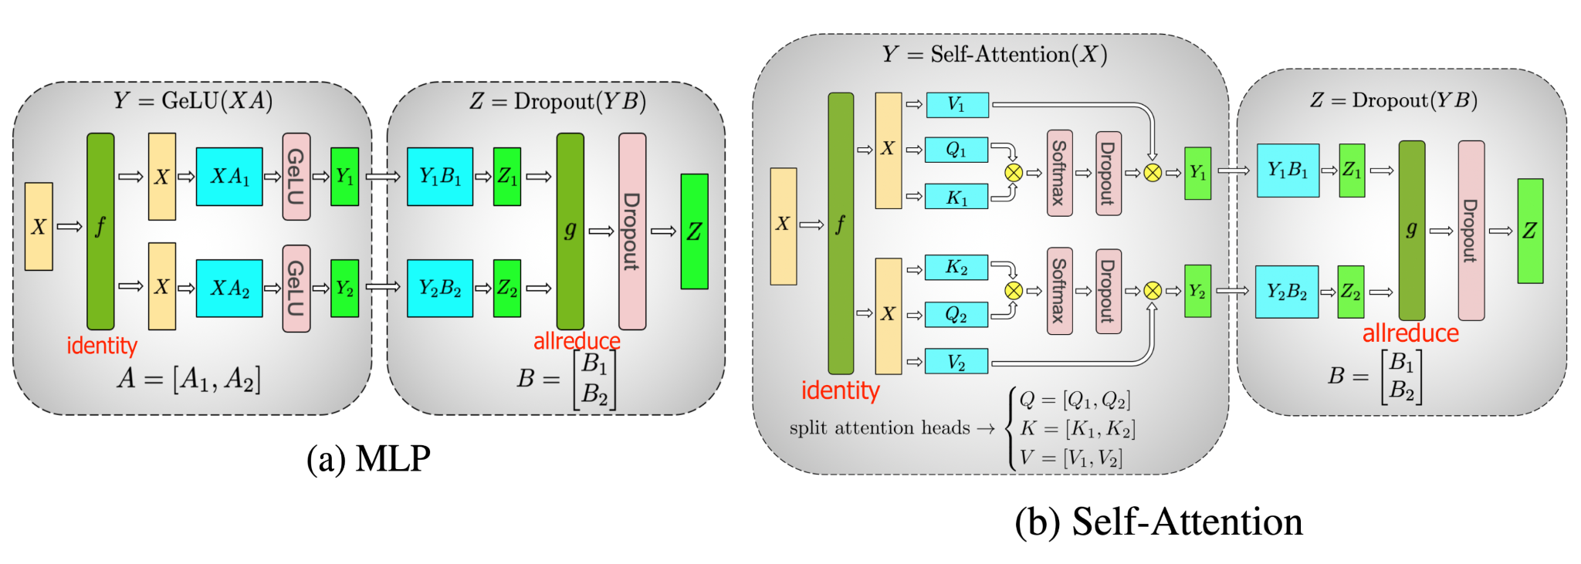
When the model is too big:
Tensor Parallelism
4D Parallelism:
Data Parallelism
Tensor Parallelism
Re-write model code
Combine collumn/row slicing to reduce sync points
Pipeline Parallelism
Sequence Parallelism

Slide 47
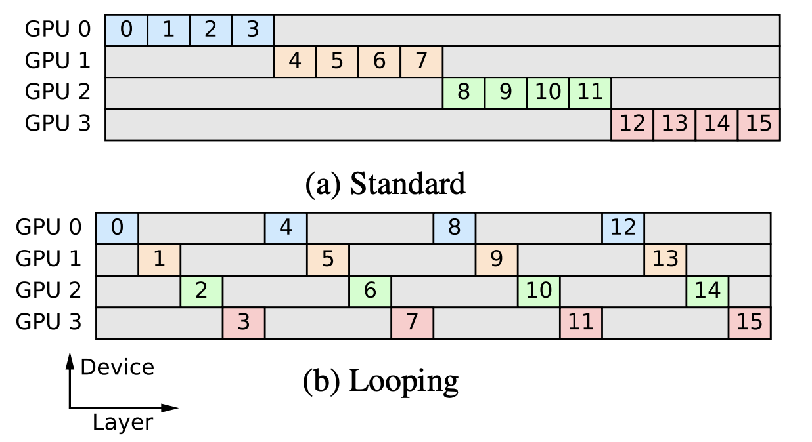
When the model is too big:
Pipeline Parallelism
4D Parallelism:
Data Parallelism
Tensor Parallelism
Pipeline Parallelism
Groupe sub-parts of the network
Challenge to keep all GPU busy
Sequence Parallelism

Slide 48
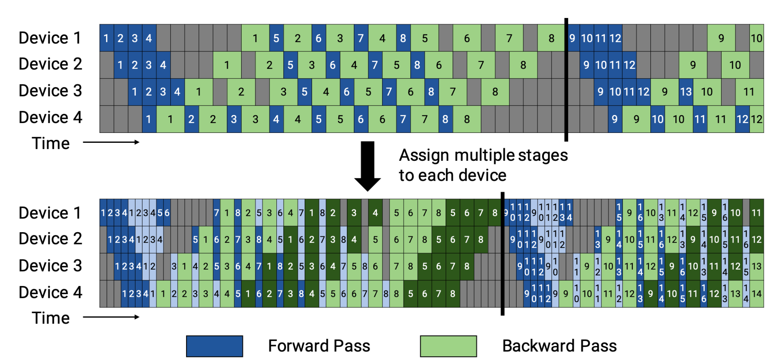
When the model is too big:
Parallelism
4D Parallelism:
Data Parallelism
Tensor Parallelism
Pipeline Parallelism
Groupe sub-parts of the network
Challenge to keep all GPU busy
Sequence Parallelism

Slide 49
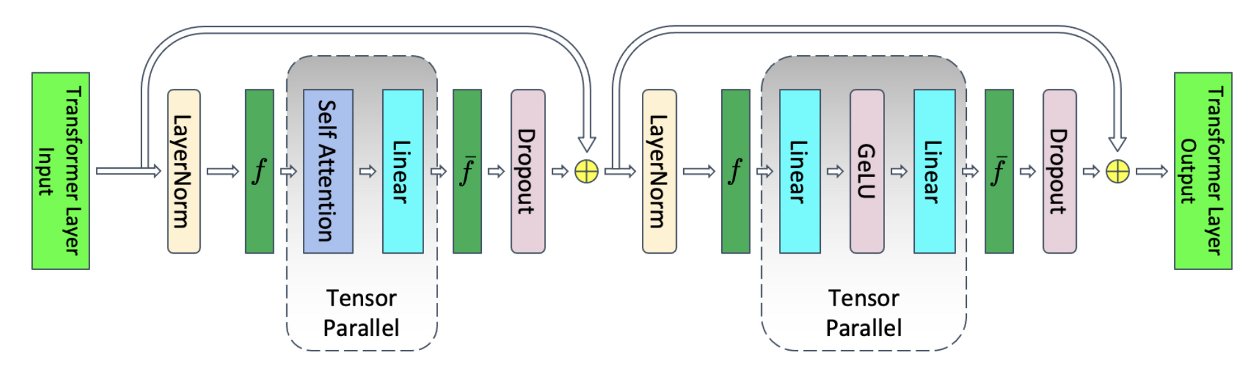
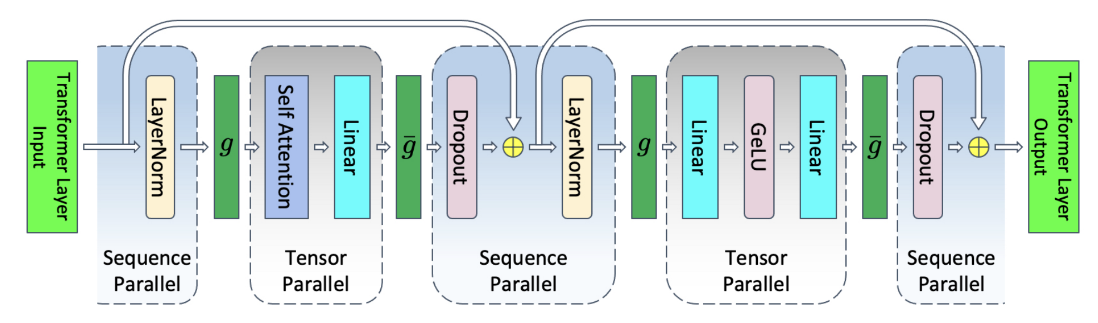
When the model is too big:
Parallelism
4D Parallelism:
Data Parallelism
Tensor Parallelism
Pipeline Parallelism
Sequence Parallelism
Add another parallelism
Be careful: another “sequence parallelism” exists: “ring attention” (also interesting)
Usually only interesting during training

Slide 50
When the model is too big:
Parallelism
References:
Breadth-First Pipeline Parallelism https://arxiv.org/abs/2211.05953
Reducing Activation Recomputation in Large Transformer Models https://arxiv.org/abs/2205.05198
Sequence Parallelism: Long Sequence Training from System Perspective https://arxiv.org/abs/2105.13120

Slide 51
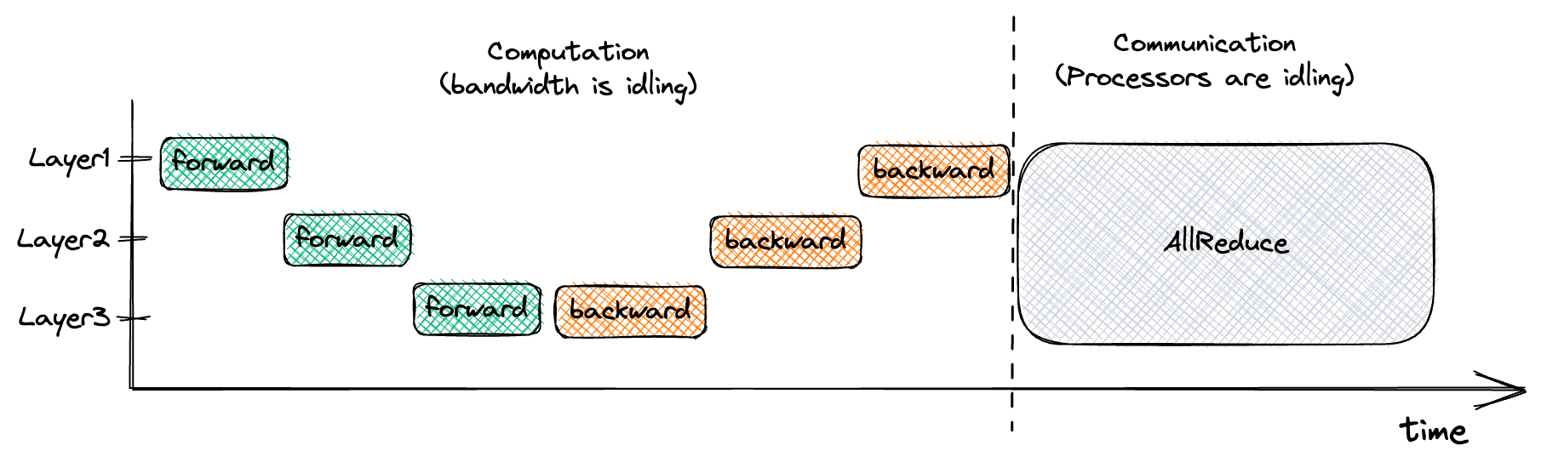
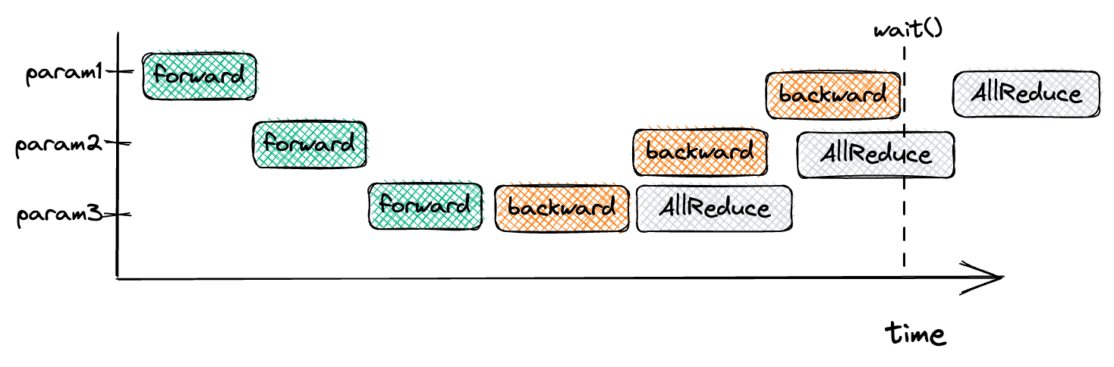
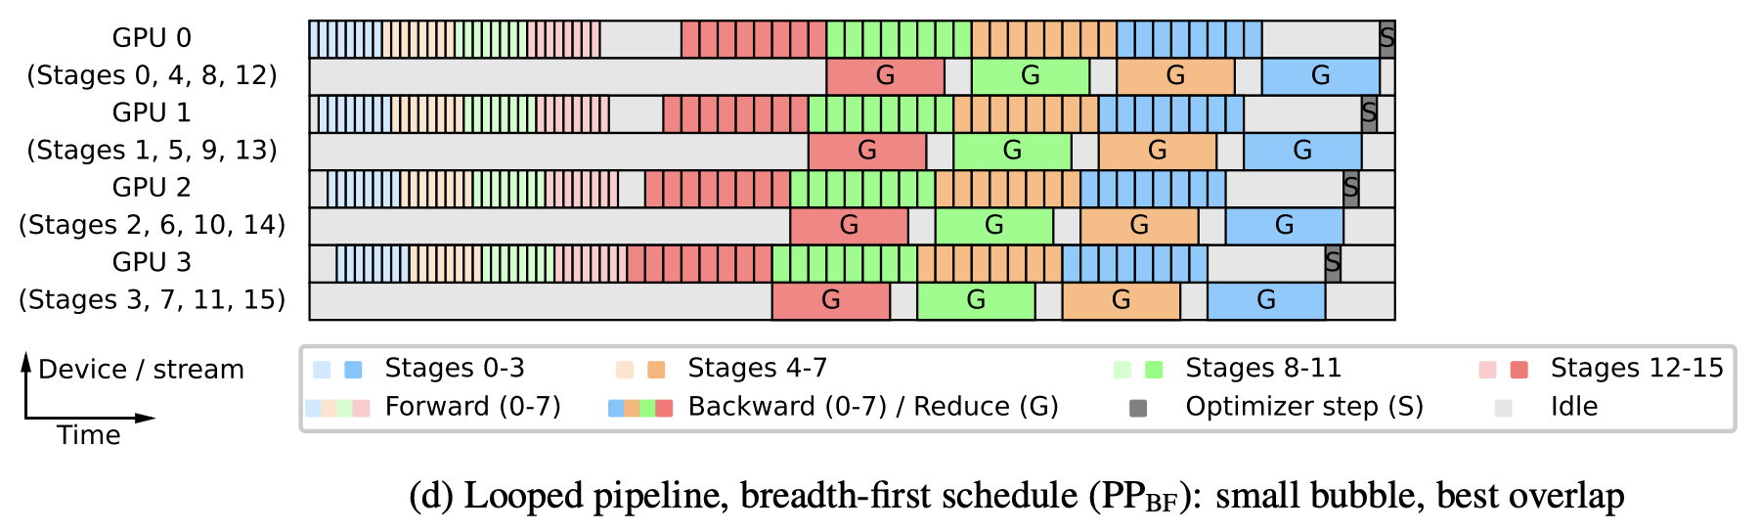
When the model is too big: efficiency
Challenges when scaling to multiple GPUs
Synchronization between:
Multiple GPUs
CPU and GPUs
Example:
Data parallelism all_reduce overlapping communication and computation

Slide 52
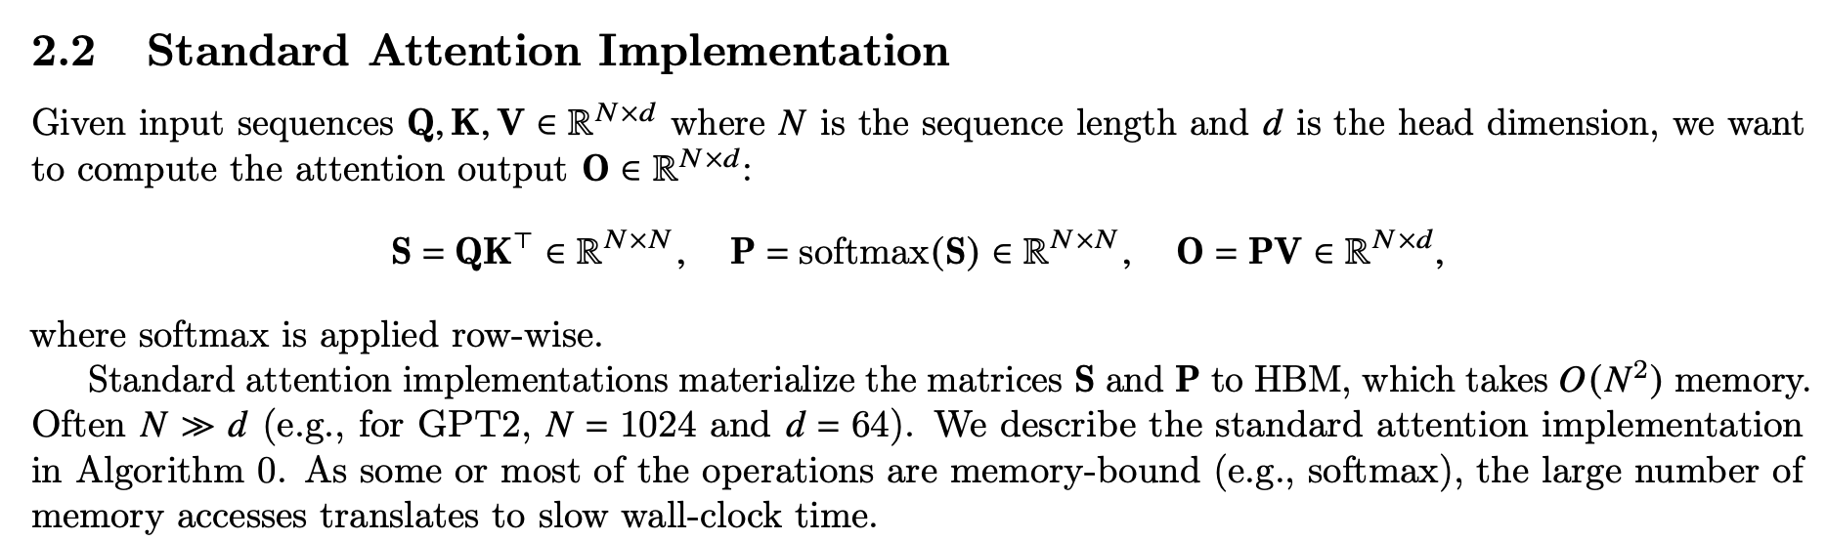
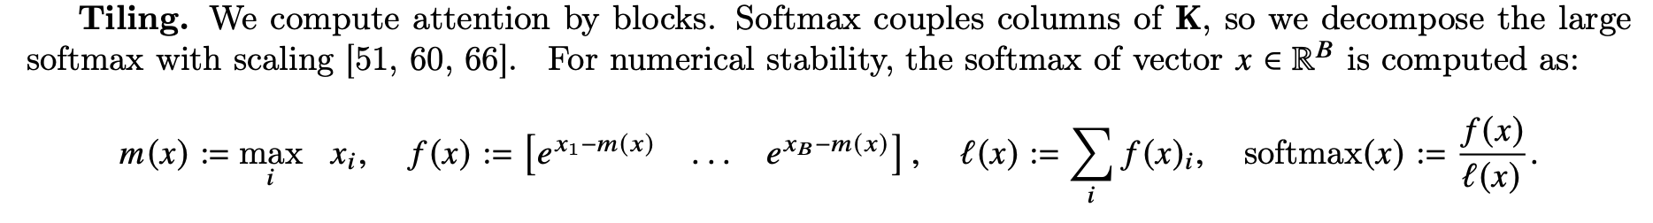
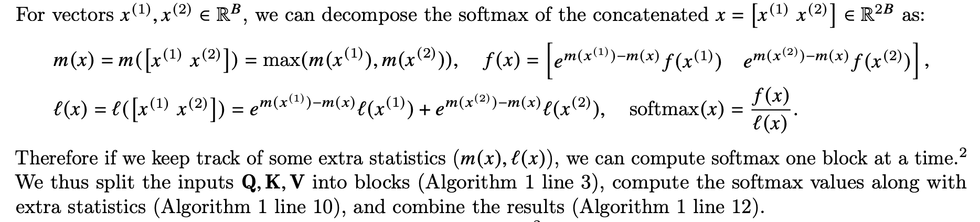
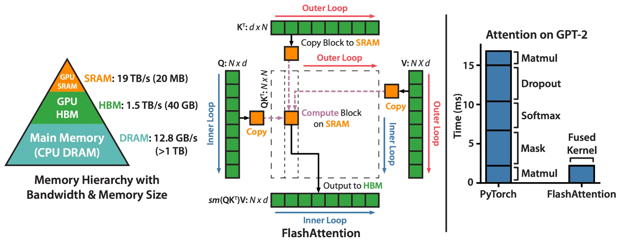
Flash Attention
Stop materializing attention matrices!

Slide 53
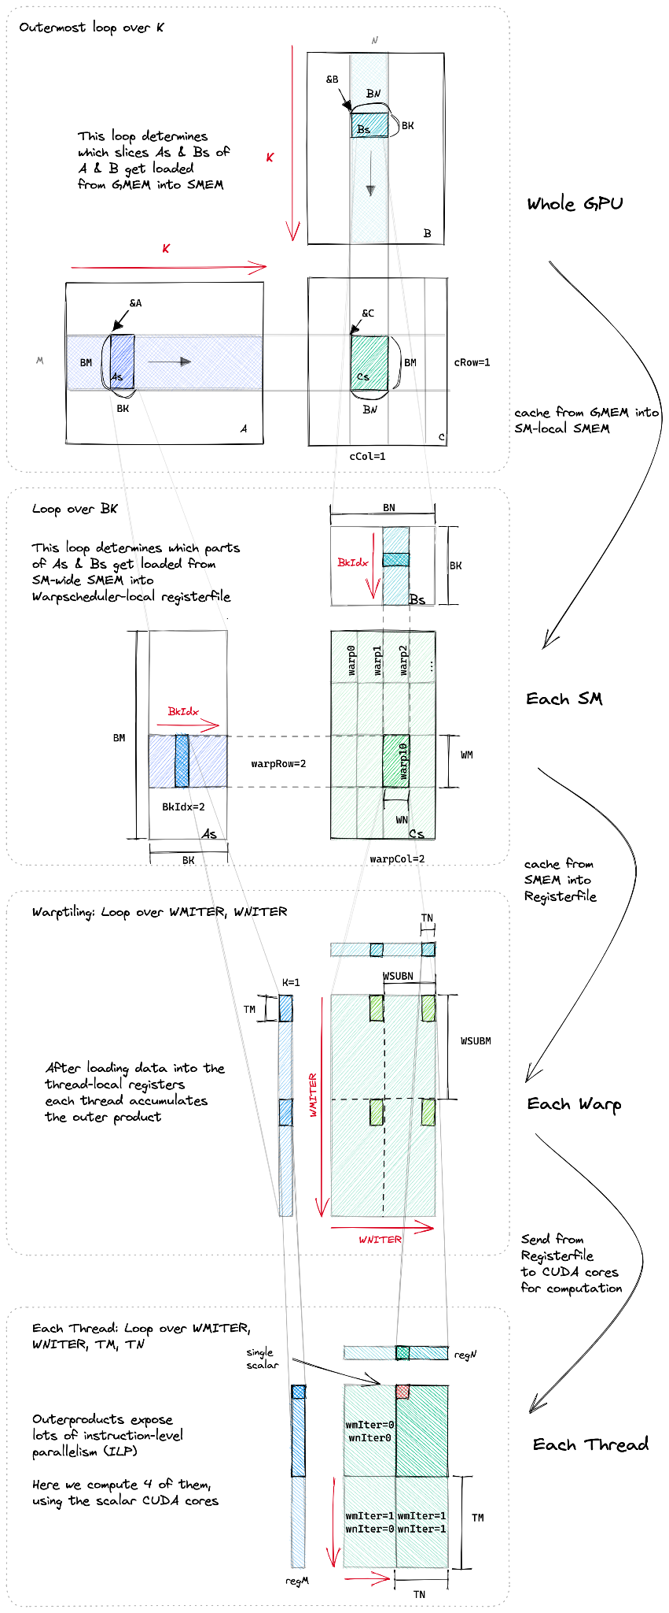
Flash Attention v2
Flash attention V2:
reduce the number of non-matmul FLOP (division, etc)
each non-matmul FLOP is 16× more expensive than a matmul FLOP
better parallelism (sequences)
causal masks
better work partitioning (blocks, wraps)

Slide 54
Stable training recipes
Initialization
Stabilisation (see MuTransfer)
Learning rate: Cosine or not.
Scaling hyper-parameters results
References:
MiniCPM blog post
Tensor Programs V: Tuning Large Neural Networks via Zero-Shot Hyperparameter Transfer https://arxiv.org/abs/2203.03466
Cerebras-GPT: Open Compute-Optimal Language Models Trained on the Cerebras Wafer-Scale Cluster
https://arxiv.org/abs/2304.03208

Slide 55
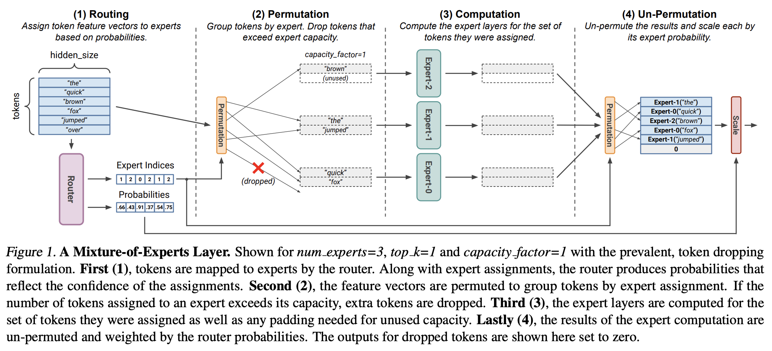
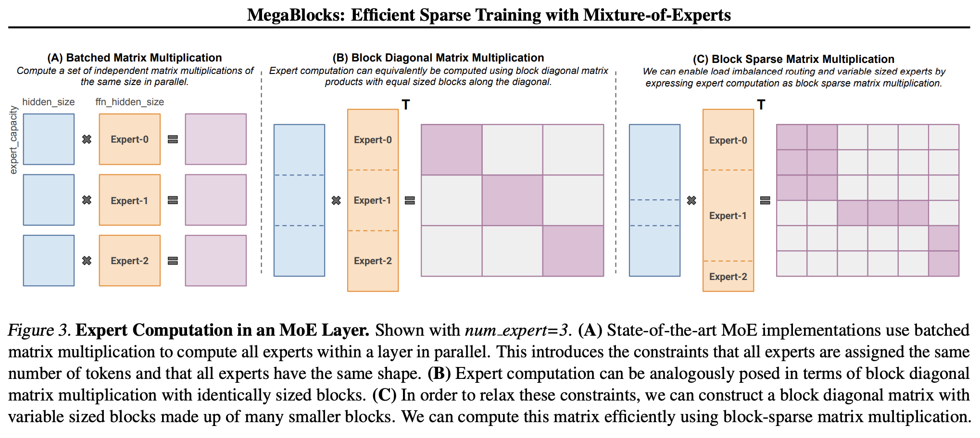
Capacity and architectures
Recent developments
Mixture-of-Experts (MoE)
Efficient training on GPUs with Block Sparsity

Slide 56
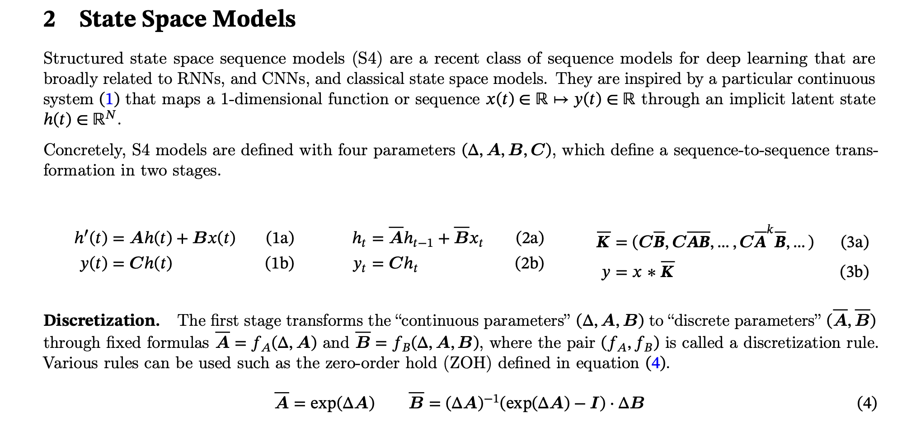
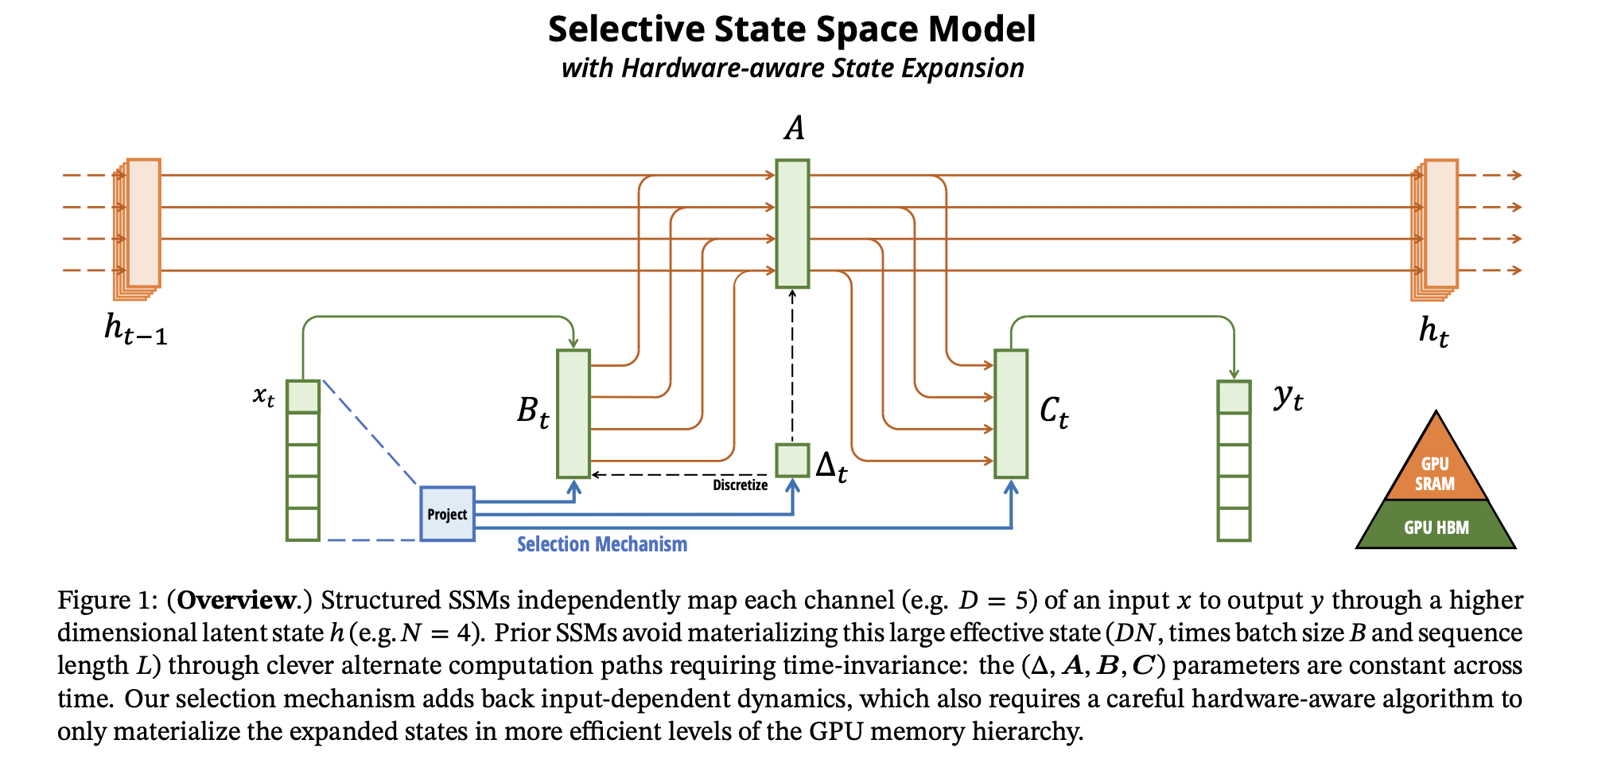
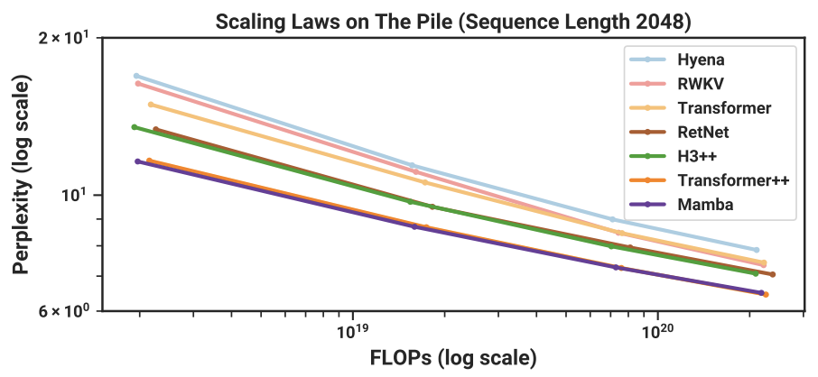
Capacity and architectures
Recent developments: Mamba
efficient and performant SSM
https://srush.github.io/annotated-mamba/hard.html

Slide 57
nanotron
Quick intro

Slide 58
nanotron
Minimalistic large language model 3D-parallelism training
Philosophy
Make it fast
Make it minimal
Make everything explicit instead of transparent
We support the following
3D parallelism, including 1F1B pipeline engine
ZeRO-1 optimizer
FP32 gradient accumulation
Parameter tying/sharding
Architectures
Llama
Mamba
MoE

Slide 59
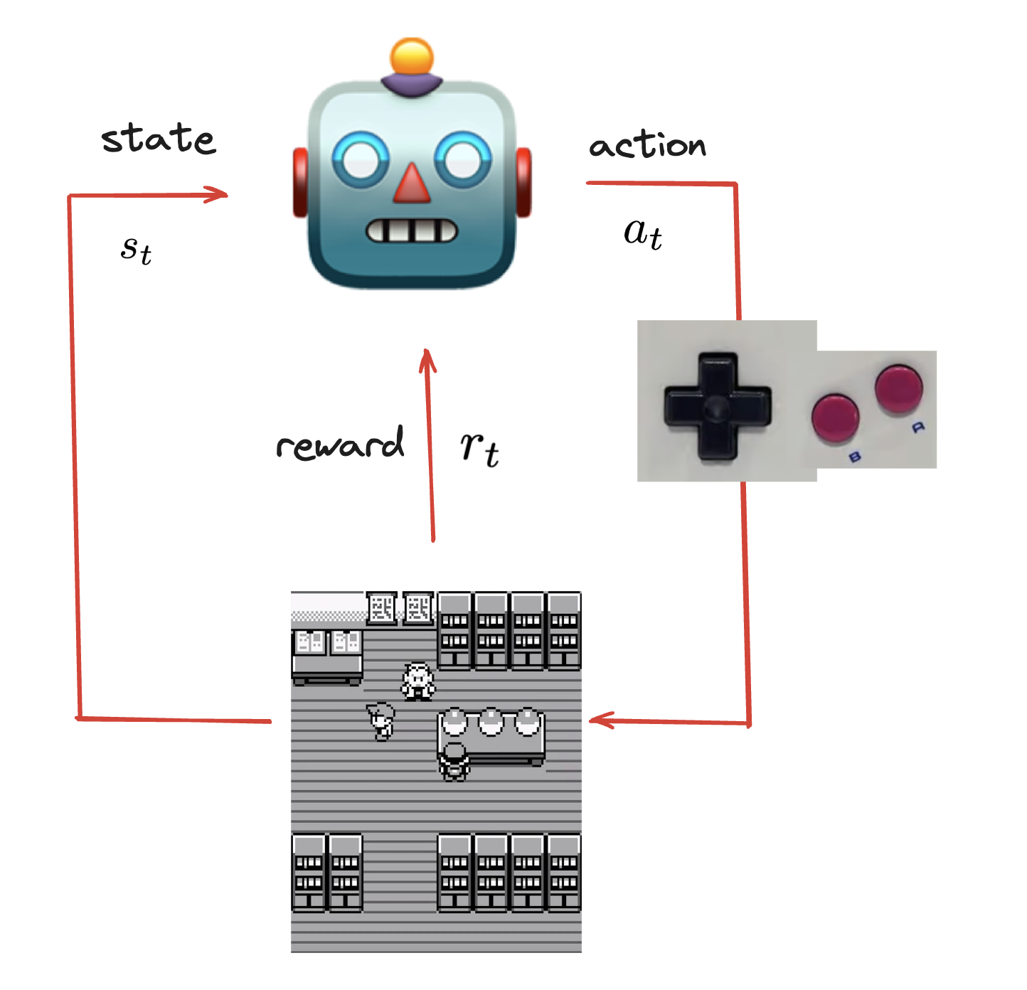
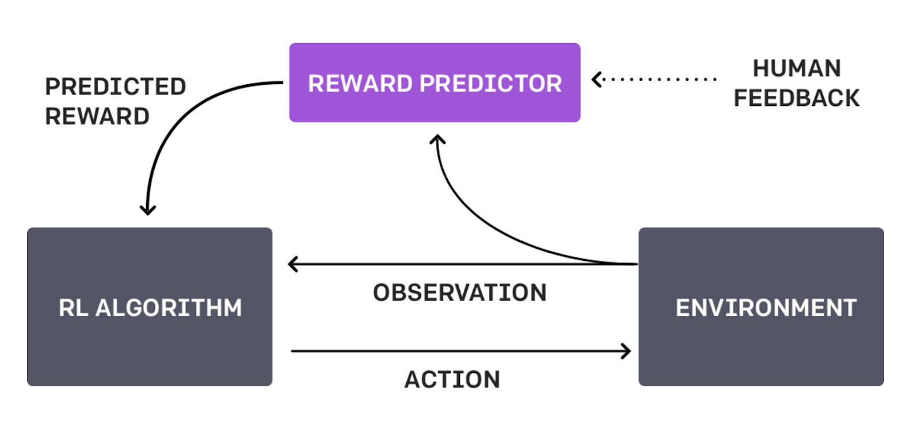
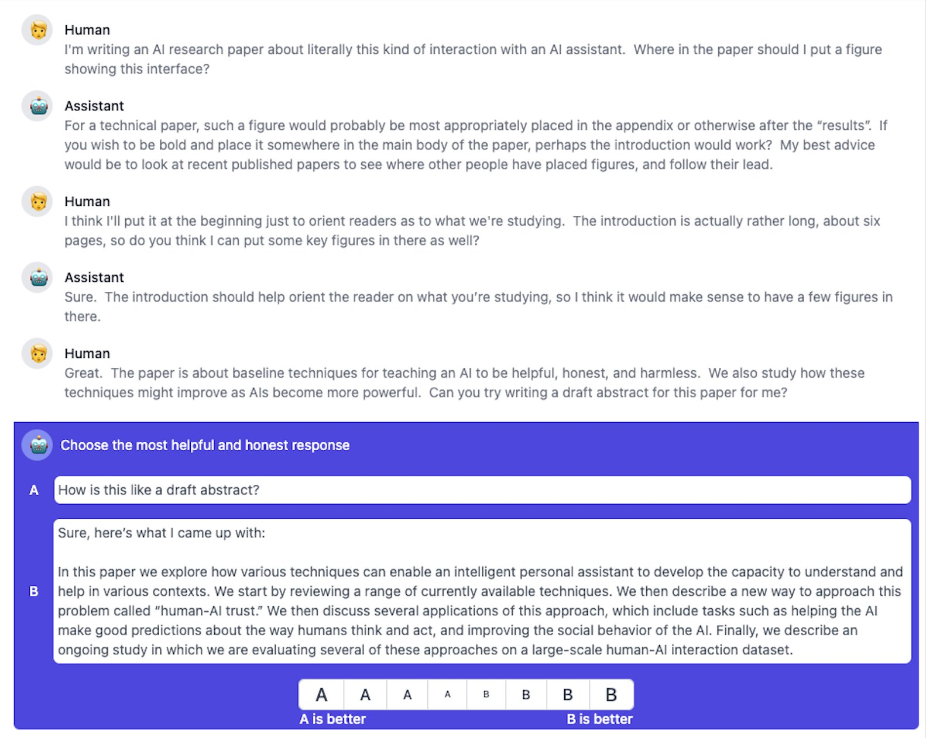
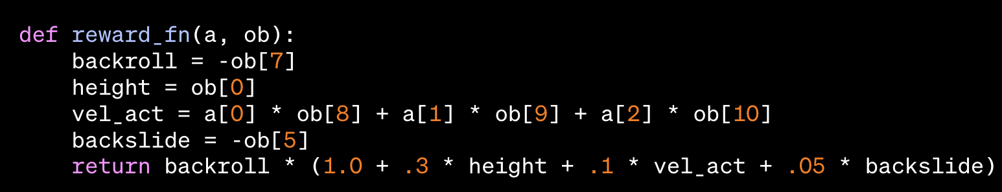
Alignment
RLHF in 2024:
Align the model’s outputs with human’s preferences
hard to design reward functions for RL

Slide 60
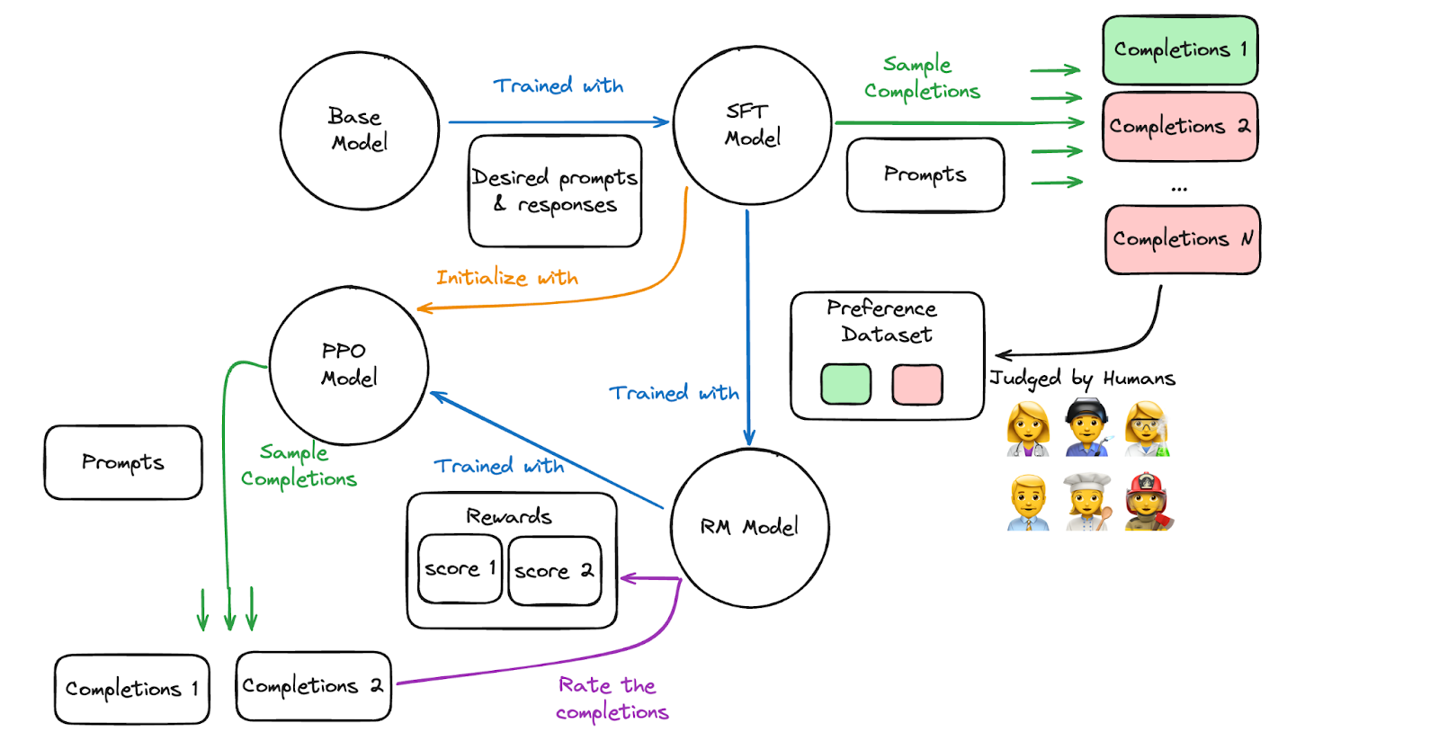

Alignment
RLFH in 2024: PPO
🤯 results are incredible
❌ implementation is complicated
❌ GPU memory (fit 4 models) 🤯

Slide 61





Alignment
RLFH in 2024: DPO
✅ results are great
✅ Implementation is easy
✅ Fits in GPU memory well (2 models)

Slide 62




Alignment
RLFH in 2024: Is PPO/on-policy RL out yet?

Slide 63

Inference
Quantization:
Full quantization for inference: GPTQ/GGML/NF4 https://arxiv.org/abs/2210.17323 Comparison of all three technics
AutoGPTQ
lama.cpp
Speculative Decoding
Use a small and large model in parallel
Medusa: https://arxiv.org/abs/2401.10774
Compiling and CUDA graphs
Accelerating Generative AI with PyTorch II: GPT, Fast

Slide 64




Final step!

Slide 65
Thank you!
Questions ?

Slide 66














Commercial solutions
1
Enterprise Hub
Private and securely hosting and tooling for enterprise collaboration on models, datasets and compute
Spaces
Build, host, and share your ML applications using Spaces in just a few minutes.
Get started with free compute and upgrade easily as needed.
2
Expert acceleration program
World-class experts to support your ML team reach impact
Inference endpoints
Deploy and call your models as APIs in a few clicks
Models
500k+ open models
Datasets
90k+ open datasets
ML Libraries
Transformers, Tokenizers, Autotrain and many more free libraries and tools
Hardware
Specialized hardware optimized for production

